Slide 1

Constellation Energy Corp(Ticker: CEG)
Karnvir Singh Rajasansi; Nolan Nikolic; Alejandro Brooks; Dylan Hein, Eghan Ryan

Slide 2

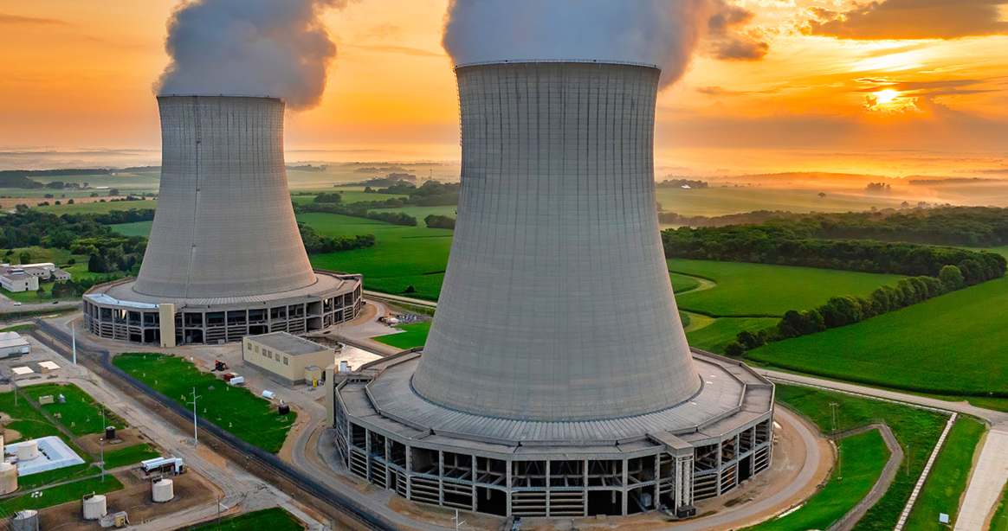
Recommendation: BUY
Current Price: $275
Target Price: $372
Implied Return: 35%
Timeline: 12+ months
Thesis 1: Constellation is the primary beneficiary of the AI Power Supercycle, positioned to capture the massive shift in U.S. electricity demand driven by AI.
Thesis 2: By providing co-located, grid-independent power, Constellation enables hyperscalers to bypass national infrastructure backlogs and achieve immediate operational readiness.
Thesis 3: Constellation leverages the nation’s largest clean energy fleet to provide the 24/7 reliability and operational flexibility essential for a carbon-free, AI-driven economy.
Notes:
20-30 seconds , go over Buy, timeline and, summary of thesis

Slide 3
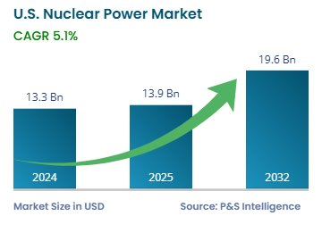
Industry Overview
~$433B
US nuclear energy market (2025)
~160%
Projected data center power demand growth by 2023
-Nuclear subsidies from the Inflation Reduction Act
Carbon-free energy incentives
Tight power supply
Market Size and Growth
Regulatory Tailwinds
AI & Data Center Boom
Decarbonization Mandates
Grid Reliability
Drivers

Slide 4
Business Overview
Constellation Energy | Nasdaq: CEG
CEG is the largest private-sector power producer in the world and #1 US clean energy supplier
55 GW
Total Generating Capacity
$25.5B
Total Revenue 2025
80%
Fortune 100 Energy Customers
21
Nuclear Reactors Across 12 sites
Business Segments
Strategic Highlights
Nuclear Generation
Natural Gas & Renewables
Clean Energy Solutions
Three Mile Island Restart
Hyperscale PPA Pipeline
Calpine Acquisition
$5B Share Buyback

Slide 5
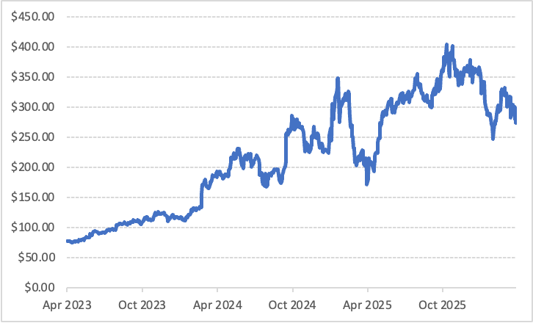
Annotated stock chart
Sept 2023 - License extensions for Byron and Braidwood nuclear plants to operate until 2046-2047
Sept 2024 – 20-year power purchase agreement with Microsoft
January 2025 – CEG announces acquisition of Calpine.
March 2025- U.S. Government reports on scraping power auctions
May 2025 - Clean Energy Center fast-tracked for interconnection to the grid

Slide 6
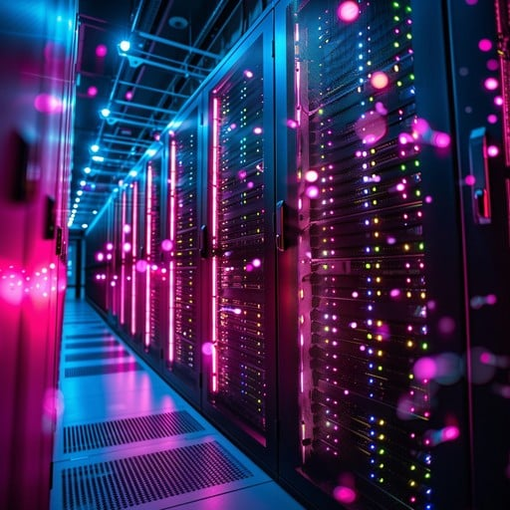
Capitalizing on the AI-Driven Power Supercycle
The Demand Surge: Data center power consumption is on track to hit 10% of total U.S. electricity by 2030, fueled by the relentless scale of LLM training.
The Nuclear Solution: Constellation's nuclear fleet offers the only 24/7 carbon-free energy source capable of matching the uptime requirements of hyperscale infrastructure.
Premium Value Capture: AI operators prioritize speed-to-market and reliability over base-load costs, creating a unique environment for premium power pricing.

Slide 7
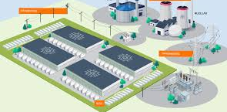
Bypassing the Grid via Grid-Independent Solutions
Zero Wait Times: Co-location allows hyperscalers to escape the national grid backlog, turning decade-long delays into immediate operational readiness.
Optimized Delivery: Localized power generation provides a stronger infrastructure layer, reducing complexity and increasing energy efficiency at the rack level.
Value Chain Expansion: Moving closer to the end-user transforms power from a commodity into a strategic asset, securing long-term, high-margin contracts.

Slide 8
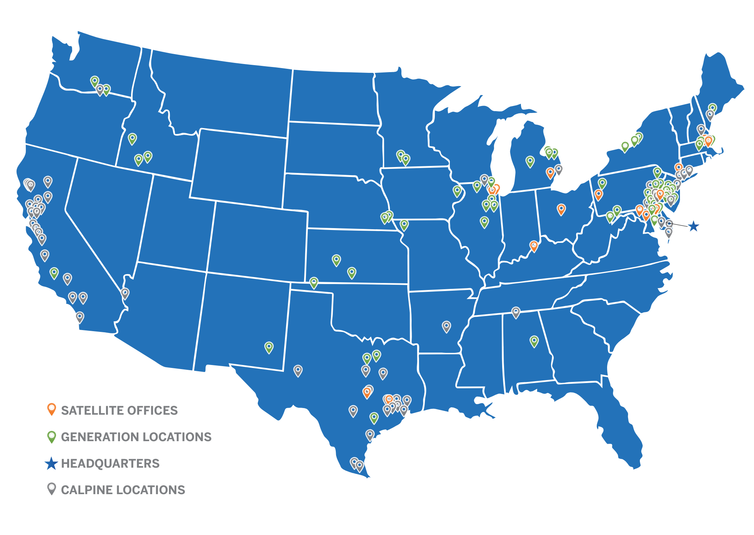
Strategic Dominance via the Nation's Largest Clean Energy Platform
Operational Alpha: Proprietary expertise and a specialized workforce transform the U.S. nuclear fleet into a scalable, high-margin platform.
Portfolio Synergy: The Calpine acquisition isn't just about capacity; it’s about the strategic flexibility to stabilize the grid as renewable penetration increases.
Resilient Cash Flows: Diversified market exposure shields the bottom line from localized regulatory headwinds, ensuring consistent ROI.

Slide 9




Risks
Regulatory: Navigating new FERC co-location fees and AI integration rules.
Infrastructure: Upgrading PJM transmission lines to bypass grid congestion.
Execution: Scaling 24/7 carbon-free power following the $22B Calpine merger.
Market: Balancing IRA benefits against profit compression from low natural gas prices.
Notes:
Market; The Inflation Reduction Act (IRA) (2022) provides a nuclear energy price floor through the Section 45U "Zero-Emission Nuclear Power Production Credit," supporting existing plants with a base subsidy of
(0.3 cents/kWh). This credit acts as a floor, helping generators stay profitable when wholesale power prices are low.

Slide 10
Comparable Analysis
Company | Price | Shares Out (M) | Market Cap (M) | EV (M) | EBITDA | EV/EBITDA | EPS | P/E
Constellation Energy | 275.17 | 362.82 | 98,984.45 | 105660.00 | 6639.00 | 15.92 | 7.46 | 36.87
Vistra | 151.18 | 341.55 | 51,636.07 | 76958.98 | 4285.00 | 17.96 | 2.19 | 69.06
NRG Energy | 152.69 | 217.58 | 33,222.50 | 42645.15 | 3686.00 | 11.57 | 3.95 | 38.67
Public Service Enterprise | 81.82 | 499.56 | 40,873.74 | 64259.00 | 4550.00 | 14.12 | 4.22 | 19.4
Exelon | 49.33 | 1023.74 | 50,501.04 | 103157.00 | 8787.00 | 11.74 | 2.73 | 18.04
Average | 142.04 | 489.05 | 55043.56 | 78536.03 | 5589.40 | 14.26 | 4.11 | 36.41

Slide 11
Valuation
Bear: Changing regulations may lead to uncertainty, higher costs, and potential delays.
Base: Revenue continues to grow with market expectations, with stable profitability.
Bull: CEG continues to capitalize on the AI driven power super cycle.
Scenario | EV/EBITDA | Implied EV | Implied Share Price | Implied Return
Bear | 10.00 | 94950 | 223 | -19%
Base | 11.97 | 113655.15 | 292 | 6%
Bull | 15 | 142425 | 372 | 35%
Notes:
Explain ev/ebitda and why we chose ebitda and used it to get EV, don’t say how we get ev but say the implied return. 1 minute; why are are multiplies lower than current we are being conservative looking at the comparable companies, lower base and bull we are being conservative, bull is avg of the teir one companies

Slide 12
Porter 5 forces
Threat of New Entrants: Low
Buyer Bargaining Power: Moderate
Nuclear plants cost billions of dollars
Takes 10-15 years to build
Regulatory approval near impossible
Utilities have many power generation options to choose from.
Very few alternatives for 24/7 carbon-free power for big tech companies.
Long term PPA's with companies
Supplier Bargaining Power: Low
Uranium is globally available
Long term contracts with suppliers
Multiple fuel fabricators, and suppliers
Competitive Rivalry: Moderate
Threat of New Substitutes: Low
Few nuclear competitors
Competing with gas/renewables for wholesale market share
Only a few companies competing to provide 24/7 carbon-free power for AI data centers
Solar/wind energy is cheaper but less consistent.
Natural gas is more expensive long term, but cheaper to build

